Slide 1
Music Generator Deep Learning Application
Daniel Rodin and Tal Gottfeld Ben-Ze’ev August ’21 Boot Camp

Slide 2
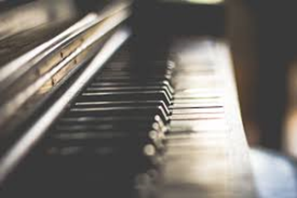
Table of Content
Project’s Scope
Introduction to Music Basics
Key Challenges in Music Generation
Preprocessing
Our Generator
Benchmarking Our Machine with the Market Developments

Slide 3
1.Project’s Scope
Our goal was to apply deep learning to music.
Therefore, we created a music generator.

Slide 4
2.Introduction to Music Basics
What is music?
Basic structure of music (piano illustration)
Note, Chord, Octave
The selected data representation type

Slide 5
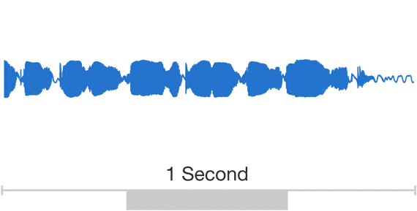
2.Introduction to Music Basics
What is music?
Music is the art of arranging sounds in time through the elements of melody, harmony, rhythm, and timbre
Analog signal that having two components: Amplitude and Frequency.

Slide 6
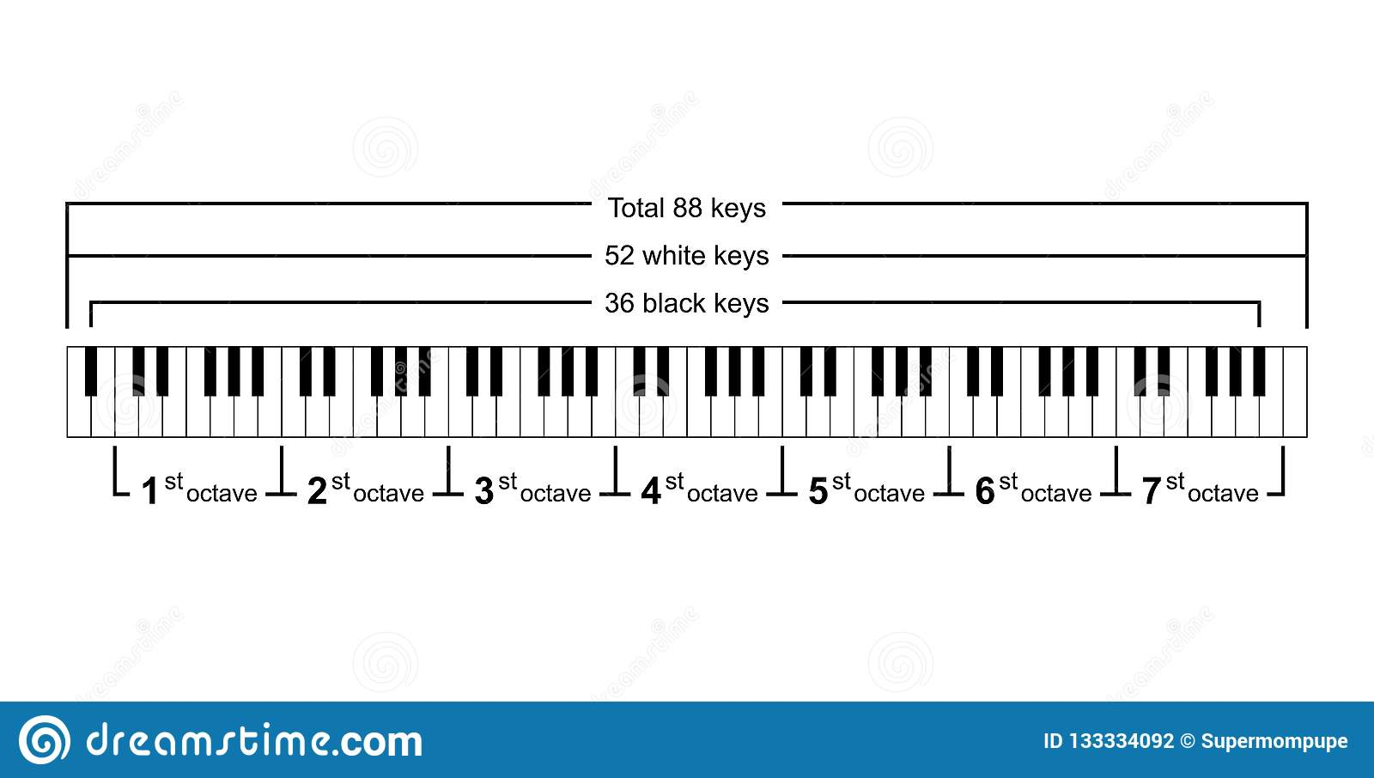
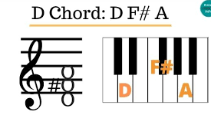
2.Introduction to Music Basics
Basic structure of music (piano illustration)
Note, Chord, Octave

Slide 7
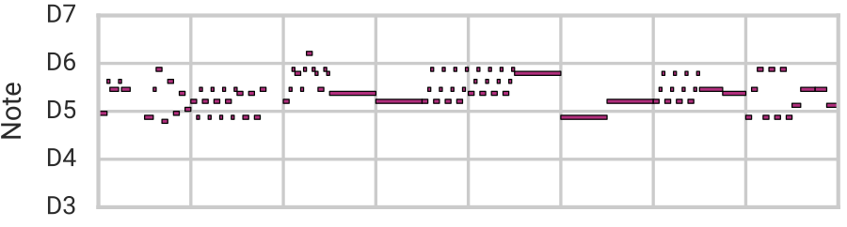
2.Introduction to Music Basics
The selected music representation type: We focused on sound files, and in particulare
midi. files

Slide 8
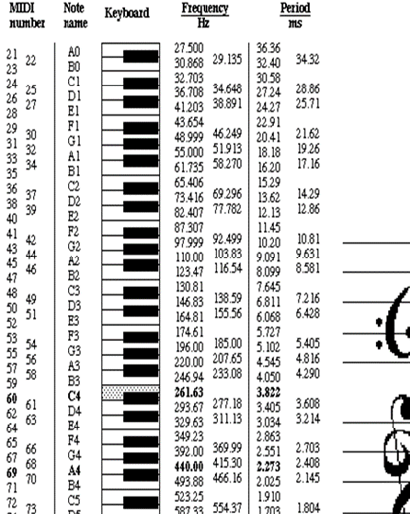
2.Introduction to Music Basics
Data Representation (Cont.):

Slide 9
3. Key Challenges in Music Generation
Complexity of data representation
Solutions: Music21, PrettyMidi, Librosa
Creativity or imitation - the risk of plagiarism
Control - Tonality, maximum number of repeated notes, rhythm..
Long sequences representation

Slide 10
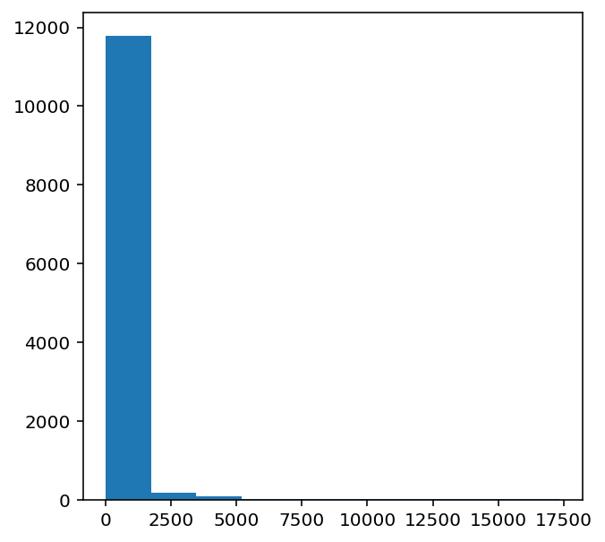
4. Preprocessing
Converter(parser) – midi converter
Build
Instruments - instrument.partitionByInstrument
Notes
Chords
What’s missing?
Duration
Offset
Frequency of notes. We will inset only the frequent notes to our model.

Slide 11
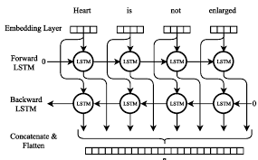
5. Our Machine
Basic package: Music21
Machine Architecture:
3 NN based on:
Embedding layer
Cov 1D
BidLSTM
SoftMax layer

Slide 12
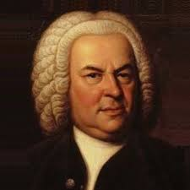
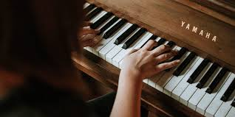
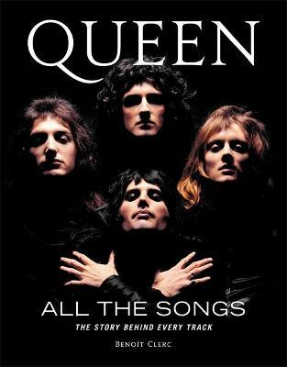

5. Our Machine - Results
Bach Chorales
Maestro
Queen
500~ files
500~ files
150~ files

Slide 13
6. Benchmarking Our Machine with the Market Developments
Leading research groups in recent years: Magenta at Google and CTRL (Creator Technology Research Lab) at Spotify
AI music generators:
MusicVAE
WaveNet
MuseNet
AVIA
AmperMusic

Slide 14
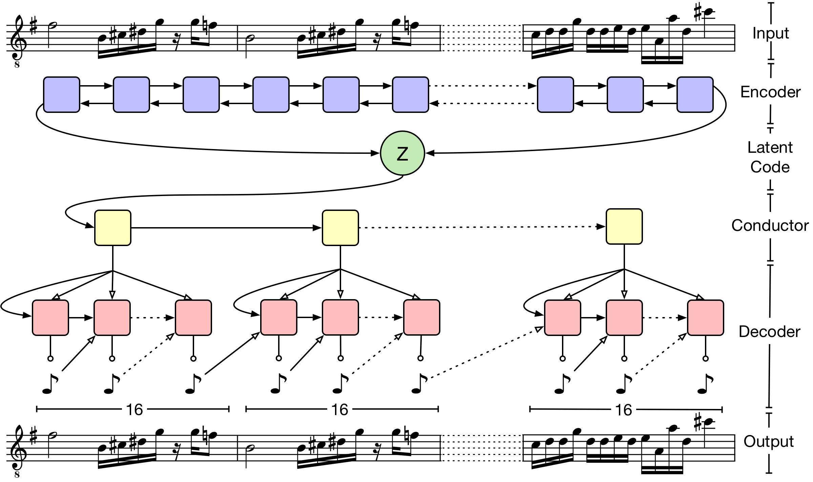
5. Benchmarking Our Machine with the Market Developments
MusicVAE

Slide 15
5. Summary
Music generation using deep learning techniques has developed profoundly in the past two decades. From the use of RNN with LSTM NN, to the great leap via CNNs as shown in WaveNet in 2016.
We were fortunate to apply a simple NN we created with success. Our efforts have not yet come to a close. We would like to explore the capabilities of more complex architectures in order to maximize the music representation.

Slide 16

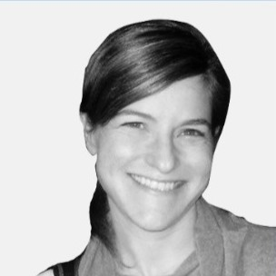
Thank You!
Daniel Rodin Data Scientist
+972-54-496-5270
Rodin.danny@gmail.com
Tal Gottfeld Ben Ze’ev Data Scientist
+972-54-481-8728
Tal.Gottfeld@gmail.com
Further reading:
https://drive.google.com/drive/folders/1BHum0kljSh-oNjaAKu0jEu1g2ZRVn3Kq?usp=sharing
Look us up in git!

